Slide 1
Thesis Statements
Turning a question
into a thesis statement
Note: you are taking notes on text in YELLOW

Slide 2

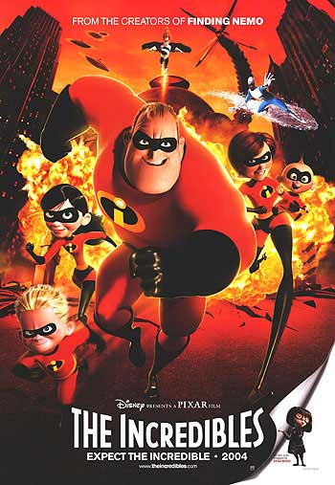
Levels of Questions
Literal = Text only.
A literal question is based directly on the text. It is fact and not open to opinion or negotiation.
Example from The Incredibles: What is Mr. Incredible’s day job?

Slide 3
Levels of Questions
Inferential: Text + Self
An inferential question asks you to combine information from the text with your own prior knowledge and understanding to make an educated guess: an inference.
Example from The Incredibles : Why is Elastigirl so opposed to Dash going out for track?

Slide 4
Levels of Questions
Evaluative: Text + Self + World
An evaluative question asks you to look at the broader picture, to make connections between the text, your understanding, and a connection to the world— ask yourself “Why does it matter?”
Example from The Incredibles : How does our contemporary fixation with being number one impact our capacity for self awareness?

Slide 5
Turn the question into a statement
How does our contemporary fixation with being number one impede our capacity for self awareness?
First: answer the question
Second: Create the statement connected to the text.
Our contemporary fixation with winning has a detrimental effect on self-awareness as evidenced by the character Dash in the Pixar film The Incredibles.

Slide 6
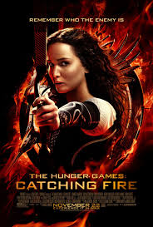


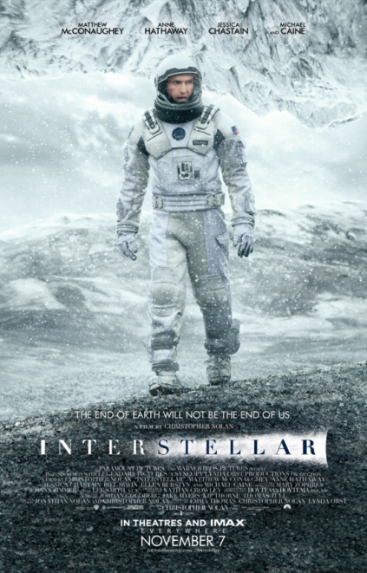
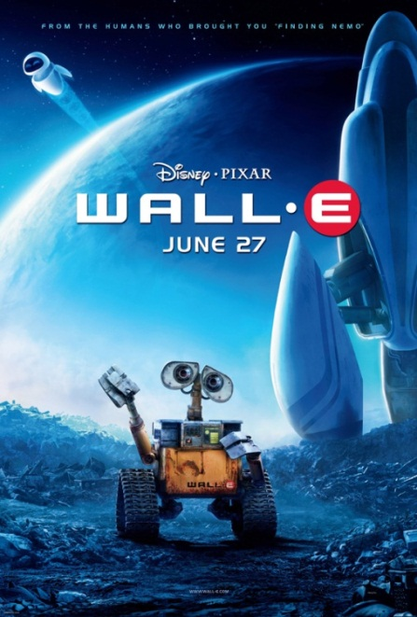
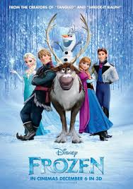
Three Levels of Questions
Create three questions for one of these films:
  Literal, Inferential, Evaluative

Slide 7
Turn your evaluative question into a statement
Evaluative Question:
Thesis statement:

